Slide 1

Stock AI Assistant (Android/Web App) 1st Hons Meeting Finn Zhan Chen - 10th October 2018

Slide 2
Problem
Cost
Expensive to access industry experts/premium services for stock advice and reccomendations
Time
Hard to manage multiple stock investment manually
Big data
Large number of public financial news, technical analysis, and fundamental analysis not leveraged effectively for average users
High value domain
A single wrong investment could lead to huge losses or not getting the most out of the investment

Slide 3
Importance
Less friction to invest
Fintech companies like Degiro, Robinhood, and E-trade allows individuals to trade painlessly
No industry leader
No particular stock AI assistant dominates the market
Technical challenge
A accurate and continuously self improving stock prediction model is hard for absolute price increases rather than up or down
User Interface
A user-friendly human to computer interaction (consumer facing prototype)

Slide 4
Challenge
Company Analysis
How to make use large historical data publicly available for technical analysis and fundamental analysis?
Sentiment Analysis
How to make use large source of information available online such as financial news, and social media?
Pseudo Real Time
How does the assistant treats new information everyday?
How often should the model be retrained with new information?
User Interface
What features are most important to an average user?
What is a typical user persona?

Slide 5
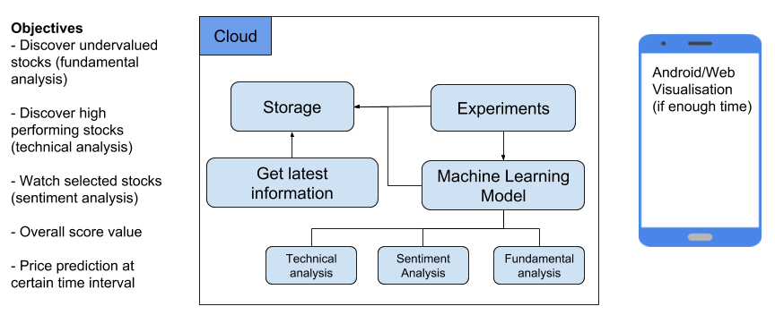
Potential Solution(s)

Slide 6
Data source found for machine learning
Current Progress
Fundamental Analysis
SimFin API provides quarterly 59 indicator (revenue, cost, earnings) for 500+ companies from 2009 to now
Technical Analysis
SimFin API and Yahoo Finance provides historical stock price for 2000+ companies from 2009 to now
Financial News
Google Finance API, investing.com, Bloomberg, Yahoo Finance API
Social Media
Twitter API for retrieving tweets in the past 7 days and 3 years worth of tweets in StockNet (Yumo’s)

Slide 7
Gantt Chart
Timeline
Semester 1:
Focus on full-time job hunt
Focus on planning Hons project
Focus on Masters application
Semester 2:
Minimal work from other courses, can devote almost full-time for Hons project
Data source mining
Sep
Research & Reading
Oct
System Design
Nov
Development
Dec-Mar
Interim Write-up
Jan
Visualisation
Mar
Final Write-up
Mar-Apr
Submission
(4 Apr 2019)
Start
Semester 1
Semester 2

